Slide 1
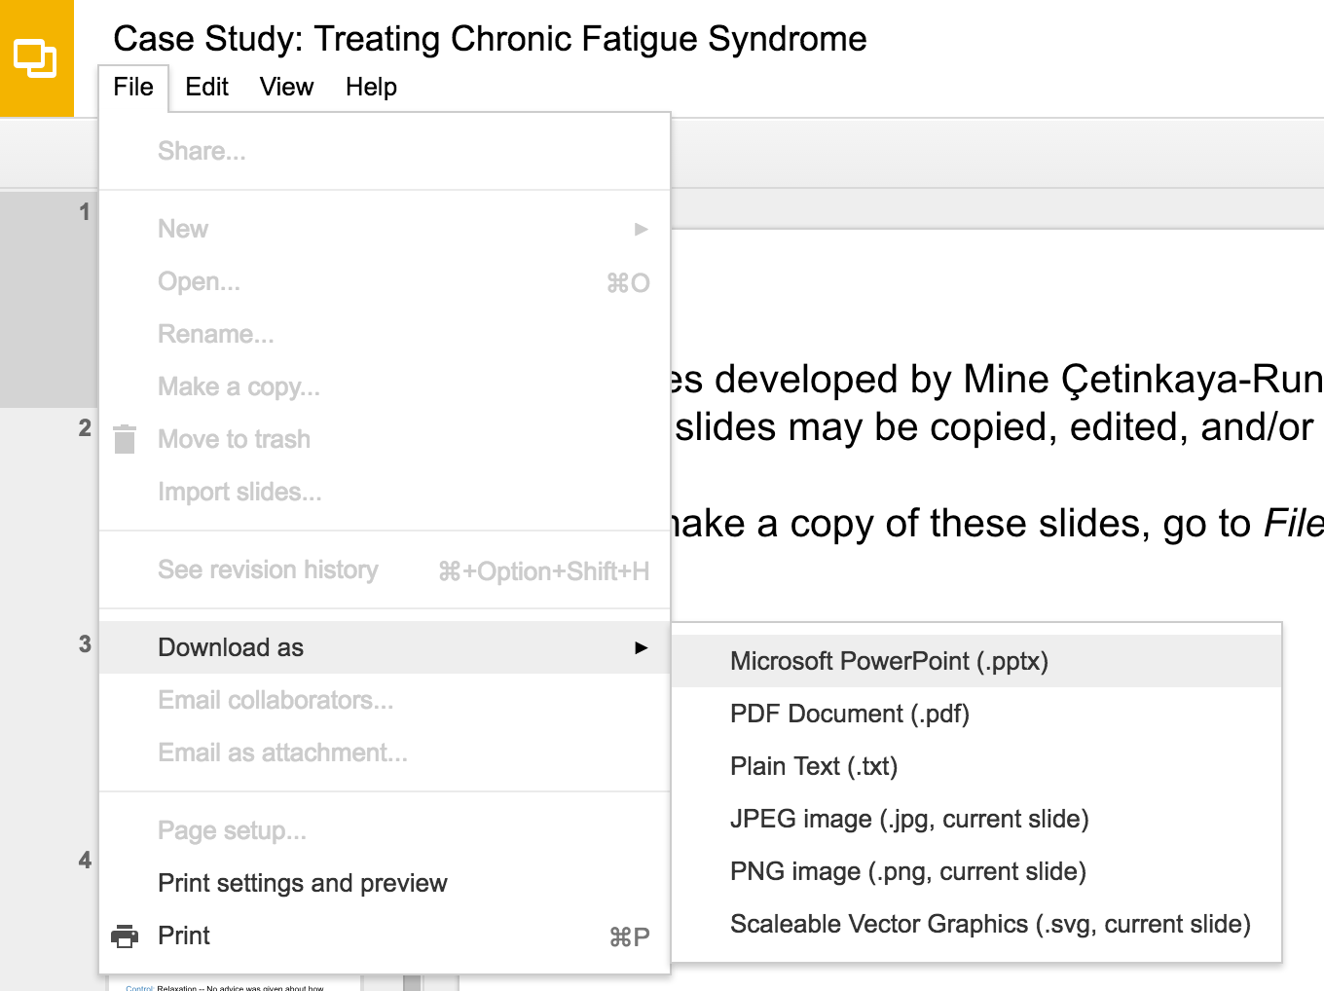
Slides developed by Mine Çetinkaya-Rundel of OpenIntro
Translated from LaTeX to Google Slides by Curry W. Hilton of OpenIntro.
The slides may be copied, edited, and/or shared via the CC BY-SA license
To make a copy of these slides, go to File > Download as > [option], as shown below. Or if you are logged into a Google account, you can choose Make a copy... to create your own version in Google Drive.

Slide 2
Conditional
Probability

Slide 3
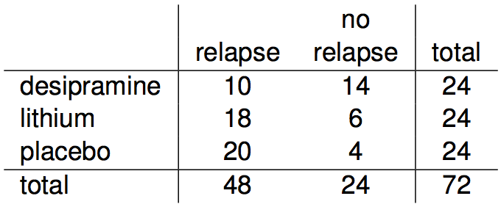
Relapse
Researchers randomly assigned 72 chronic users of cocaine into three groups: desipramine (antidepressant), lithium (standard treatment for cocaine) and placebo. Results of the study are summarized below.
http://www.oswego.edu/~srp/stats/2_way_tbl_1.htm

Slide 4
Marginal probability
What is the probability that a patient relapsed?

Slide 5
Marginal probability
What is the probability that a patient relapsed?
P(relapsed) = 48 / 72 ~ 0.67

Slide 6
Joint probability
What is the probability that a patient received the antidepressant (desipramine) and relapsed?

Slide 7
Joint probability
What is the probability that a patient received the antidepressant (desipramine) and relapsed?
P(relapsed and desipramine) = 10 / 72 ~ 0.14

Slide 8

Conditional probability
The conditional probability of the outcome of interest A given condition B is calculated as

Slide 9
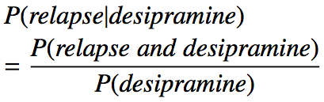
Conditional probability
The conditional probability of the outcome of interest A given condition B is calculated as

Slide 10

Conditional probability
The conditional probability of the outcome of interest A given condition B is calculated as

Slide 11

Conditional probability
The conditional probability of the outcome of interest A given condition B is calculated as

Slide 12

Conditional probability
The conditional probability of the outcome of interest A given condition B is calculated as

Slide 13
Conditional probability (cont.)
If we know that a patient received the antidepressant (desipramine), what is the probability that they relapsed?

Slide 14
Conditional probability (cont.)
If we know that a patient received the antidepressant (desipramine), what is the probability that they relapsed?
P(relapse | desipramine) = 10 / 24 ~ 0.42

Slide 15
Conditional probability (cont.)
If we know that a patient received the antidepressant (desipramine), what is the probability that they relapsed?
P(relapse | desipramine) = 10 / 24 ~ 0.42
P(relapse | lithium) = 18 / 24 ~ 0.75
P(relapse | placebo) = 20 / 24 ~ 0.83

Slide 16
Conditional probability (cont.)
If we know that a patient relapsed, what is the probability that they received the antidepressant (desipramine)?

Slide 17
Conditional probability (cont.)
If we know that a patient relapsed, what is the probability that they received the antidepressant (desipramine)?
P(desipramine | relapse) = 10 / 48 ~ 0.21

Slide 18
Conditional probability (cont.)
If we know that a patient relapsed, what is the probability that they received the antidepressant (desipramine)?
P(desipramine | relapse) = 10 / 48 ~ 0.21
P(lithium | relapse) = 18 / 48 ~ 0.38
P(placebo | relapse) = 20 / 48 ~ 0.42

Slide 19
General multiplication rule
Earlier we saw that if two events are independent, their joint probability is simply the product of their probabilities. If the events are not believed to be independent, the joint probability is calculated slightly differently.

Slide 20
General multiplication rule
Earlier we saw that if two events are independent, their joint probability is simply the product of their probabilities. If the events are not believed to be independent, the joint probability is calculated slightly differently.
If A and B represent two outcomes or events, then P(A and B) = P(A | B) x P(B) Note that this formula is simply the conditional probability formula, rearranged.

Slide 21
General multiplication rule
Earlier we saw that if two events are independent, their joint probability is simply the product of their probabilities. If the events are not believed to be independent, the joint probability is calculated slightly differently.
If A and B represent two outcomes or events, then P(A and B) = P(A | B) x P(B) Note that this formula is simply the conditional probability formula, rearranged.
It is useful to think of A as the outcome of interest and B as the condition.

Slide 22
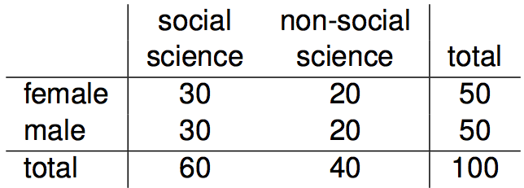
Independence and
conditional probabilities
Consider the following (hypothetical) distribution of gender and major of students in an introductory statistics class:

Slide 23
Independence and
conditional probabilities
Consider the following (hypothetical) distribution of gender and major of students in an introductory statistics class:
The probability that a randomly selected student is a social science major is

Slide 24
Independence and
conditional probabilities
Consider the following (hypothetical) distribution of gender and major of students in an introductory statistics class:
The probability that a randomly selected student is a social science major is
60 / 100 = 0.6.

Slide 25
Independence and
conditional probabilities
Consider the following (hypothetical) distribution of gender and major of students in an introductory statistics class:
The probability that a randomly selected student is a social science major is
60 / 100 = 0.6.
The probability that a randomly selected student is a social science major given that they are female is

Slide 26
Independence and
conditional probabilities
Consider the following (hypothetical) distribution of gender and major of students in an introductory statistics class:
The probability that a randomly selected student is a social science major is
60 / 100 = 0.6.
The probability that a randomly selected student is a social science major given that they are female is
30 / 50 = 0.6.

Slide 27
Independence and
conditional probabilities
Consider the following (hypothetical) distribution of gender and major of students in an introductory statistics class:
The probability that a randomly selected student is a social science major is
60 / 100 = 0.6.
The probability that a randomly selected student is a social science major given that they are female is
30 / 50 = 0.6.
Since P(SS | M) also equals 0.6, major of students in this class does not depend on their gender: P(SS | F) = P(SS).

Slide 28
Independence and
conditional probabilities (cont.)
Generically, if P(A | B) = P(A) then the events A and B are said to be independent.

Slide 29
Independence and
conditional probabilities (cont.)
Generically, if P(A | B) = P(A) then the events A and B are said to be independent.
Conceptually: Giving B doesn’t tell us anything about A.

Slide 30

Independence and
conditional probabilities (cont.)
Generically, if P(A | B) = P(A) then the events A and B are said to be independent.
Conceptually: Giving B doesn’t tell us anything about A.
Mathematically: We know that if events A and B are independent, P(A and B) = P(A) x P(B). Then,

Slide 31
Breast cancer screening
American Cancer Society estimates that about 1.7% of women have breast cancer. http://www.cancer.org/cancer/cancerbasics/cancer-prevalence
Susan G. Komen For The Cure Foundation states that mammography correctly identifies about 78% of women who truly have breast cancer. http://ww5.komen.org/BreastCancer/AccuracyofMammograms.html
An article published in 2003 suggests that up to 10% of all mammograms result in false positives for patients who do not have cancer. http://www.ncbi.nlm.nih.gov/pmc/articles/PMC1360940
Note: These percentages are approximate, and very difficult to estimate.

Slide 32
Inverting probabilities
When a patient goes through breast cancer screening there are two competing claims: patient had cancer and patient doesn't have cancer. If a mammogram yields a positive result, what is the probability that patient actually has cancer?

Slide 33
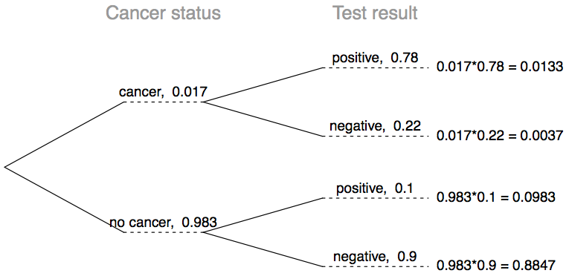
Inverting probabilities
When a patient goes through breast cancer screening there are two competing claims: patient had cancer and patient doesn't have cancer. If a mammogram yields a positive result, what is the probability that patient actually has cancer?

Slide 34

Inverting probabilities
When a patient goes through breast cancer screening there are two competing claims: patient had cancer and patient doesn't have cancer. If a mammogram yields a positive result, what is the probability that patient actually has cancer?

Slide 35

Inverting probabilities
When a patient goes through breast cancer screening there are two competing claims: patient had cancer and patient doesn't have cancer. If a mammogram yields a positive result, what is the probability that patient actually has cancer?

Slide 36

Inverting probabilities
When a patient goes through breast cancer screening there are two competing claims: patient had cancer and patient doesn't have cancer. If a mammogram yields a positive result, what is the probability that patient actually has cancer?
Note: Tree diagrams are useful for inverting probabilities: we are given P(+|C) and asked for P(C|+).

Slide 37

Inverting probabilities
When a patient goes through breast cancer screening there are two competing claims: patient had cancer and patient doesn't have cancer. If a mammogram yields a positive result, what is the probability that patient actually has cancer?

Slide 38
Inverting probabilities
When a patient goes through breast cancer screening there are two competing claims: patient had cancer and patient doesn't have cancer. If a mammogram yields a positive result, what is the probability that patient actually has cancer?
Note: Tree diagrams are useful for inverting probabilities: we are given P(+|C) and asked for P(C|+).

Slide 39
Practice
Suppose a woman who gets tested once and obtains a positive result wants to get tested again. In the second test, what should we assume to be the probability of this specific woman having cancer?
(a) 0.017
(b) 0.12
(c) 0.0133
(d) 0.88

Slide 40
Practice
Suppose a woman who gets tested once and obtains a positive result wants to get tested again. In the second test, what should we assume to be the probability of this specific woman having cancer?
(a) 0.017
(b) 0.12
(c) 0.0133
(d) 0.88

Slide 41
Practice
What is the probability that this woman has cancer if this second mammogram also yielded a positive result?
(a) 0.0936
(b) 0.088
(c) 0.48
(d) 0.52

Slide 42
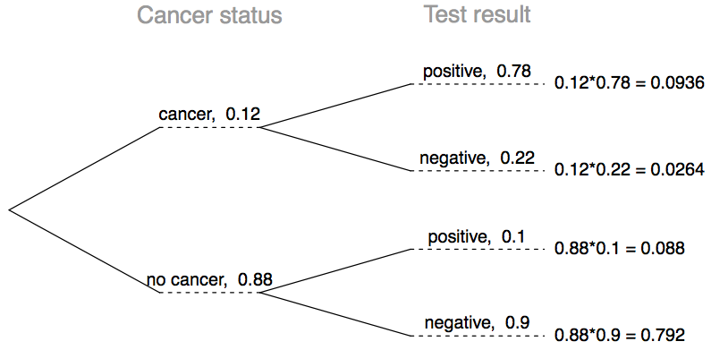
Practice
What is the probability that this woman has cancer if this second mammogram also yielded a positive result?
(a) 0.0936
(b) 0.088
(c) 0.48
(d) 0.52

Slide 43
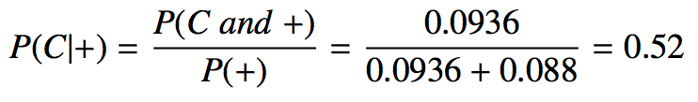
Practice
What is the probability that this woman has cancer if this second mammogram also yielded a positive result?
(a) 0.0936
(b) 0.088
(c) 0.48
(d) 0.52

Slide 44
Bayes' Theorem
The conditional probability formula we have seen so far is a special case of the Bayes' Theorem, which is applicable even when events have more than just two outcomes.

Slide 45
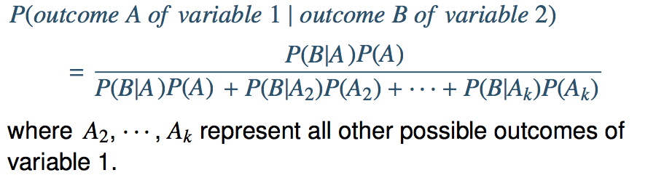
Bayes' Theorem
The conditional probability formula we have seen so far is a special case of the Bayes' Theorem, which is applicable even when events have more than just two outcomes.
Bayes’ Theorem

Slide 46
Application activity:
inverting probabilities
A common epidemiological model for the spread of diseases is the SIR model, where the population is partitioned into three groups: Susceptible, Infected, and Recovered. This is a reasonable model for diseases like chickenpox where a single infection usually provides immunity to subsequent infections. Sometimes these diseases can also be difficult to detect.
Imagine a population in the midst of an epidemic where 60% of the population is considered susceptible, 10% is infected, and 30% is recovered. The only test for the disease is accurate 95% of the time for susceptible individuals, 99% for infected individuals, but 65% for recovered individuals. (Note: In this case accurate means returning a negative result for susceptible and recovered individuals and a positive result for infected individuals).
Draw a probability tree to reflect the information given above. If the individual has tested positive, what is the probability that they are actually infected?

Slide 47
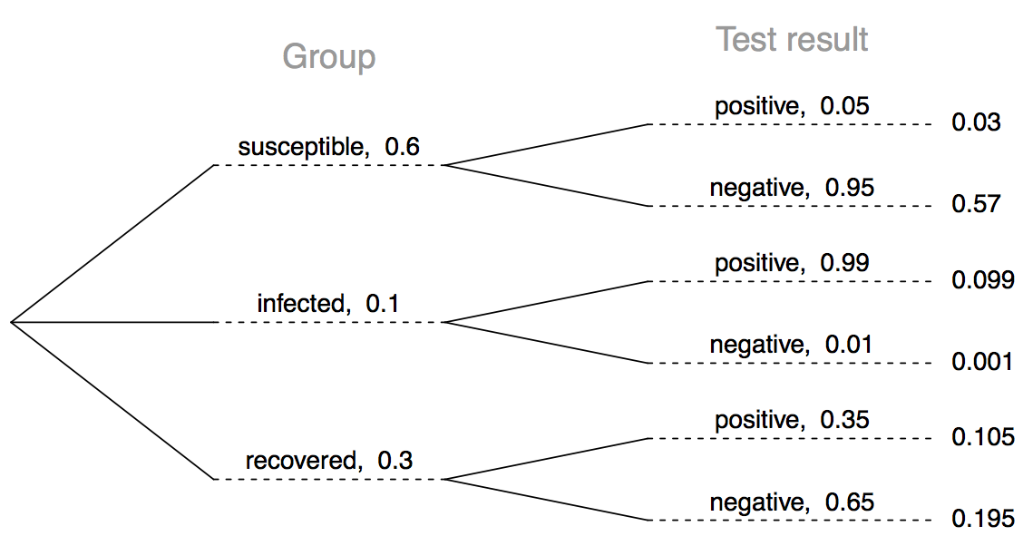
Application activity:
inverting probabilities (cont.)

Slide 48

Application activity:
inverting probabilities (cont.)

Slide 49
Find more resources at openintro.org/os, including
Slides
Videos
Statistical Software Labs
Discussion Forums (free support for students and teachers)
Learning Objectives
Teachers only content is also available for Verified Teachers, including
Exercise solutions
Sample exams
Ability to request a free desk copy for a course
Statistics Teachers email group
Questions? Contact us.

